Slide 1
DETECTING SPAM EMAILS
NAME JANANI S
NM ID au61772111039
COLLEGE GOVERNMENT COLLEGE OF ENGINEERING ,
SALEM - 11.

Slide 2
COURSE OUTLINE
Abstract
Problem statement
Aim & Objectives
Spam messages
Coding
Video of the project
Conclusion
Reference

Slide 3
abstract
Nowaday, emails are used in almost every field, from business to education. Emails have two subcategories, i.e., ham and spam. Email spam, also called junk emails or unwanted emails, is a type of email that can be used to harm any user by wasting his/her time, computing resources, and stealing valuable information. The ratio of spam emails is increasing rapidly day by day. Spam detection and filtration are significant and enormous problems for email and IoT service providers nowadays.

Slide 4
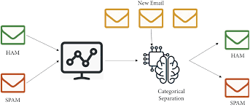
PROBLEM STATEMENT
CHAPTER 1
Unwanted emails irritating internet connection
Billions of dollars lost worldwide.
Identify theft.
Spam can crash mail servers and fill up hard device.

Slide 5

AIM & OBJECTIVES
CHAPTER 2
To give knowledge to the user about the fake emails and relevant emails
To classify the email spam or not.

Slide 6
Spam messages
The email spam definition is ambiguous since everybody has their views on it. At present, email spam is getting the attention of everyone.
A notable model is the development expense trick in which a client receives an email with an offer that should bring about a prize.

Slide 7
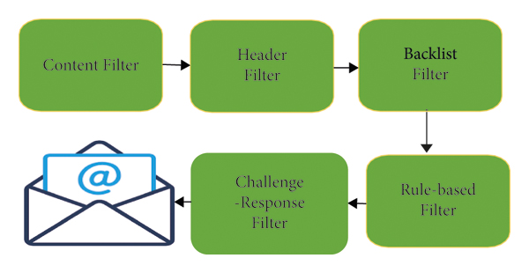
In the era of technology, the dodger/spammer shows a story where the unfortunate casualty needs forthright financial help so that the fraudster can gain a lot bigger total of cash, which they would then share.

Slide 8
CODING
CHAPTER 3
Run command below to import necessary dependencies.
import pandas as pd
from sklearn.model_selection import train_test_split
from sklearn.feature extraction_extraction.text import CountVectorizer
from sklearn import svm

Slide 9
train_test_split()
Train dataset : used to fit the machine learning model
Train dataset : used to evaluate the fit of the machine learning model
To split the data into two dataset , we’ll use scikit-learn’s
train_test_split( ) method

Slide 10
Run the command below
x = spam[ ‘ email text ’ ]
y = spam[ “ label “ ]
It contains the data we’ll run through the model.
Extracting features
cv = countvectorizer( )
features = cv.fit_transform(x_train)
countvectorizer( ) randomly assign a number to each word . It counts a number of occurance of each word, then saves it to cv.

Slide 11
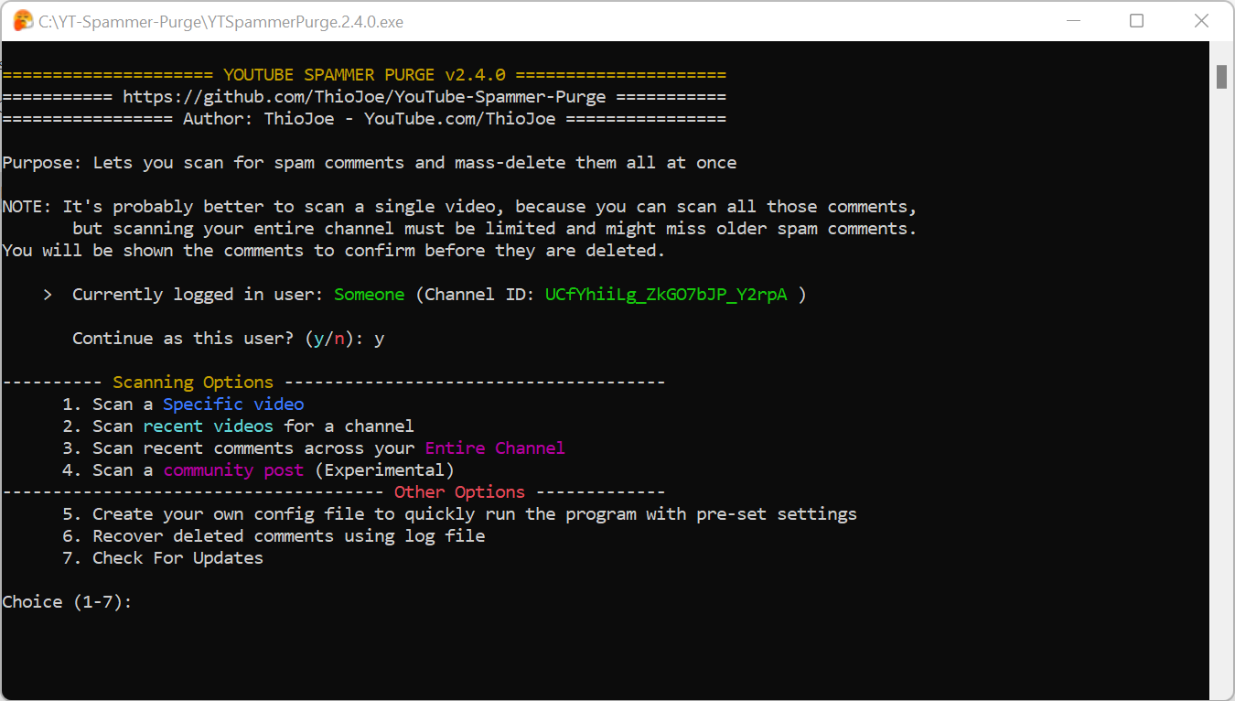
Our machine learning model will be able to predict spam
e-mails based on the number of occurences of certain word
that are common in spam emails

Slide 12
Lets create the SVM model with code below
model = svm.SVC( )
model.fit(features , y_train)
Function model.fit trains the model with features and y_train . Then ,it checks the prediction against the y_train labels and adjusts its parameters until it reaches the highest possible accuracy

Slide 13
coding
CHAPTER 4
# importing require libraries
from sklearn.features _extraction.text import countvectorizer
from sklearn.model_selection import train_test_split
from sklearn.naive_bayes import multinomialNB
from sklearn.metrics import accuracy_score , classification_report
#in this example , we create a small dataset of email text and labels
Emails = {
“get rich quick! Click here to win 100000000!” ,
“Hello ! Could you please review this project “,
“ Discount on luxurious bags and watches”,
“meeting is scheduled for you tomorrow , please attend.”
“Congratulations! you won a luxurious car”
}
Labels = [1,0,1,0,1]
#convert text data into numerical features using count vectorizer

Slide 14
Vectorizer = countvectorizer( )
X = vectorizer.fit_transform(email)
#split the data into training and testing sets
X_train , x_test, y_train, y_test = train_test_split( )
#create a multinomial naïve bayes classifier
Model = multinomialNB()
#train the model on training data
Y_pred = model.predict(x_test)
#make prediction
Y_pred = model.predict(x_test)
#evaluate the model
accuracy = accuracy_score(y_test, y_pred)
report = classification_report(y_test, y_pred)
Print(“accuracy: “,accuracy)
Print(“classification report:\n”,report)

Slide 15
# predict the email is spam or not
new_email = [“you have won 10000000”]
new_email_vectorized = vectorizer.transform(new_email)
Predicted_ label = model.predict(new_email_vectorized)
if predicted_label[0]==0
print(“predicted as not spam”)
else :
print(“predicted as spam”)

Slide 16

CHAPTER 5
VIDEO OF THE PROJECT

Slide 17
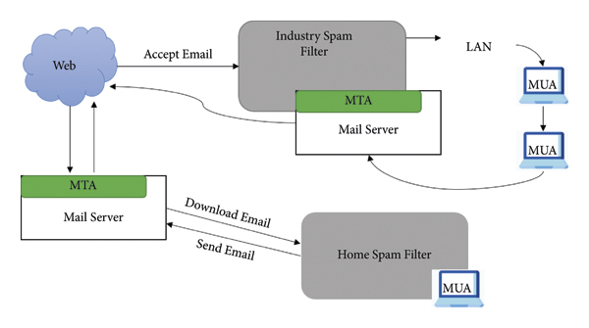

Slide 18
CONCLUSION
In the last two decades, spam detection and filtration gained the attention of a sizeable research community. The reason for a lot of research in this area is its costly and massive effect in many situations like consumer behavior and fake reviews.
The survey covers various machine learning techniques and models that the various researchers have proposed to detect and filter spam in emails and IoT platforms. The study categorized them as supervised, unsupervised, reinforcement learning, etc.

Slide 19
The study compares these approaches and provides a summary of learned lessons from each category. This study concludes that most of the proposed email and IoT spam detection methods are based on supervised machine learning techniques.
A labeled dataset for the supervised model training is a crucial and time-consuming task. Supervised learning algorithms SVM and Naïve Bayes outperform other models in spam detection. The study provides comprehensive insights of these algorithms and some future research directions for email spam detection and filtering.

Slide 20
REFERENCE
https://www.hindawi.com/journals/scn/2022/1862888/

